Slide 1
Get enrolled
Enrolment presentation and Q&A
  Semester 2 2026

Slide 2

Acknowledgement of Country
We acknowledge the Ngunnawal and Ngambri peoples as the Traditional Custodians of the land on which the ANU Acton campus is located.
We honour their continuing connection to Country and the knowledge, care and community that shape learning and belonging at ANU, and pay our respects to Elders past and present.

Slide 3


Agenda
01 | Student admin 101
02 | Choosing courses
03 | Enrolling on ANUHub
04 | Key administrative dates
05 | After enrolment
What topics will we cover today?

Slide 4




Student Admin 101
01
Who should I contact if I need help?
Does everyone else already know what these terms mean?

Slide 5
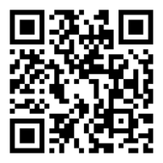
What does it mean?
Program | A structured sequence of study (courses or research). Completing your program requirements can lead to the awarding of a degree, e.g. Bachelor of Arts.
Program requirements | The rules you must follow to complete your degree. These may include required courses, majors, minors and specialisations, total units, and other conditions.
Course | A subject you study within a specific teaching session as part of your program, e.g. ECON1101 – Microeconomics 1.
Enrolment | Process of registering to participate in a course, completed on ANUHub.
Class | A scheduled activity within a course, like a lecture, tutorial, or workshop. You will allocate classes on MyTimetable to generate your personal timetable.
Teaching session | The time period during which a course is taught (e.g. Semester 1 or Summer Session)
ANU glossary:
https://quicklink.anu.edu.au/bx92

Slide 6
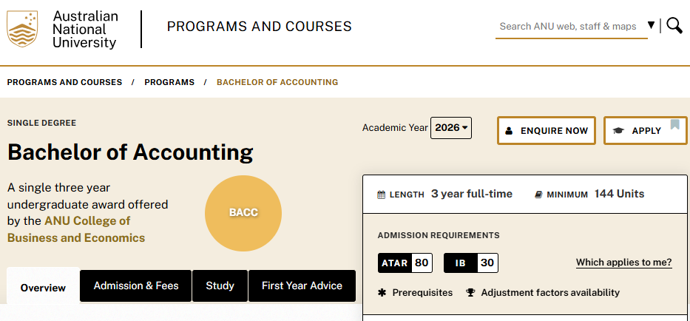
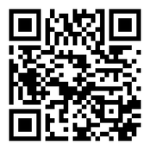
Where do I find… program and course info?
ANU Programs and Courses website
https://programsandcourses.anu.edu.au/

Slide 7
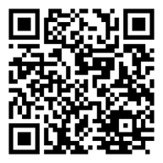
Where do I find… program planning guides?
ANU Academic College | Program planning guides
ANU College of Arts and Social Sciences (CASS) | https://cass.anu.edu.au/current-students/degrees-and-program-plans
ANU College of Asia and the Pacific (CAP) | Undergraduate: https://asiapacific.anu.edu.au/cap-student-centre#section-13346 Postgraduate: https://programsandcourses.anu.edu.au/catalogue
ANU College of Business and Economics (CBE) | https://cbe.anu.edu.au/current-students/program-planning/fast-track
ANU College of Law, Governance and Policy (CLGP) | https://law.anu.edu.au/welcome-anu-law-school
ANU College of Science and Medicine (CoSM) | Undergraduate: https://students.science.anu.edu.au/program-admin/structuring-your-degree Postgraduate: https://programsandcourses.anu.edu.au/catalogue
ANU College of Systems and Society (CSS) | https://programsandcourses.anu.edu.au/catalogue and https://systems.anu.edu.au/students/continuing/
Key student contacts
https://www.anu.edu.au/students/contacts/key-student-contacts

Slide 8
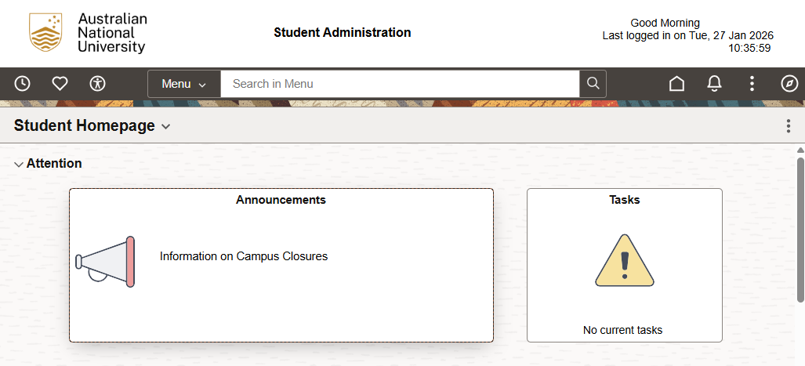
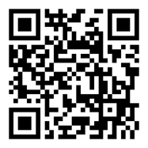
Where do I… enrol in courses?
ANUHub
https://selfservice.sas.anu.edu.au/

Slide 9


Choosing courses
02
How do I know which courses I'm supposed to enrol in?

Slide 10
Program planning
Program or degree planning is organising your studies to reach your academic and career goals.
This includes choosing courses, majors, and minors, and checking prerequisites.
Each ANU program has a set of program requirements:
    Provide the specific conditions you will need to fulfill to complete your program.
    Listed on the “Study” tab on Programs and Courses.
Program planning guides for your ANU Academic College are linked on slide 8.
ANU Programs and Courses website
https://programsandcourses.anu.edu.au/

Slide 11

    Academic year
    Select the year you commenced your degree.
    Study tab
    Your Program Requirements are detailed on this section of the program page.
    Academic contact
    Your Program Convenor is an academic staff member responsible for overseeing your program.

Slide 12
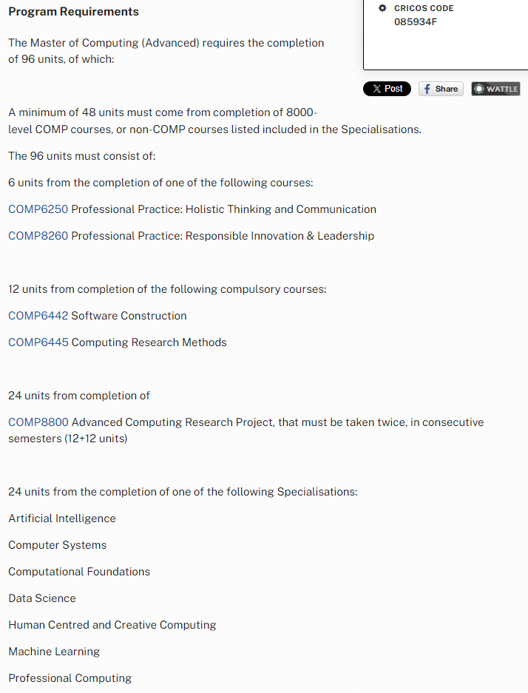
    Total number of units to complete
    Conditions you must follow within your program. For example, restrictions on certain courses (1000-level) or completion of higher-level courses (8000-level).
    List of core courses (compulsory, foundations, technical or project).
    Required majors, minors or specialisations (links can be found at the bottom of the page)

Slide 13
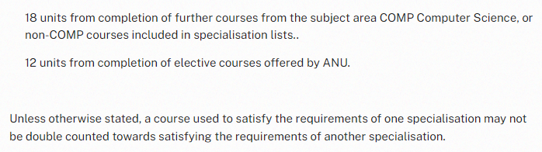
    If your program requirements include elective courses, you might have:
      Choice of specified electives (e.g. COMP- or ENGN- coded)
      Choice of unspecified electives (i.e. ANU-wide courses)
    Any other conditions/restrictions of your degree.

Slide 14

    First Year Advice tab
    This includes detailed advice for newly commencing students, including:
      Study options (e.g. single- or double-degree programs)
      Important considerations for course selection
      Information about Major, Minor, and Specialisation options
      Seeking course credit or exemptions
      Sample study plans

Slide 15


Slide 16

Course pages
    Provide important information about what it’s like to study the course such as:
    Course convenor
    Course offerings (teaching session)
    Course overview
    Learning outcomes

Slide 17
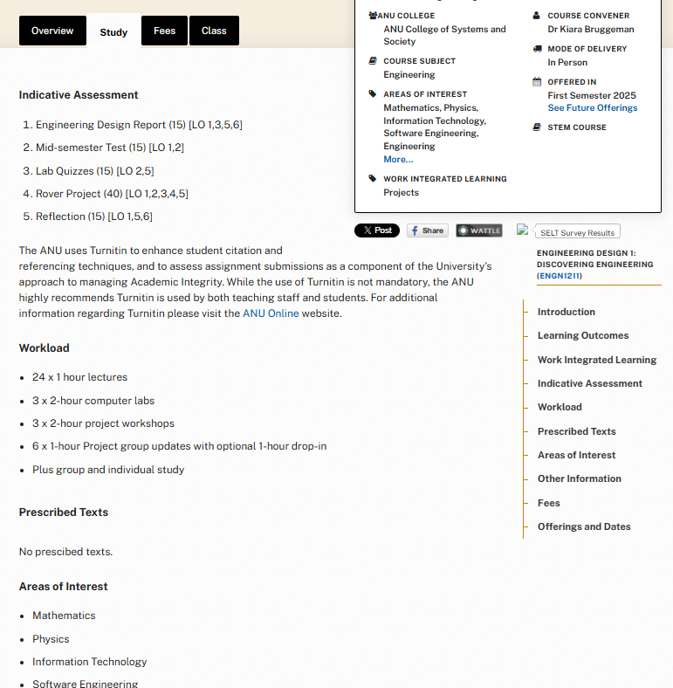
    Reviewing the Study tab will help you get an indication of what you'd be required to do while studying this course:
    Indicative Assessment for the types and value of assessment items
    Workload for the contact hours (classes such as lectures, labs and tutorials), drop-ins and independent study.
    Prescribed texts for any compulsory textbooks you'll need to source.

Slide 18

    The Class tab provides administrative information about each course offering:
    Teaching session(s)
    Class number
    Write this down – you'll use it to enrol on ANUHub)
    Enrolment deadlines
      Last date to enrol
      Census date
    Link to Class Summary
Notes:
Some courses may have their current Class Summary already available. Typically, Class Summaries will be published on Programs & Courses two (2) weeks before the start of the semester.

Slide 19

    Class Summary
    Specific to one course offering, e.g. this one is for ENGN1211 in Semester 1 2025.
    These provide more detailed information about how the course will run that teaching session:
    Overview
    Assessments
    Class schedule
    Class contacts

Slide 20
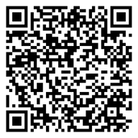
Course credit and exemptions
    If you have previous studies or professional experience that is relevant to your current academic program, you can request to receive course credit or an exemption based on your prior learning.
    There are different types of evidence required with an application for credit transfer depending if applying for formal or informal learning.
  Information + Instructions on how to submit a credit transfer application
  https://www.anu.edu.au/students/program-administration/program-management/get-course-credit-or-exemption

Slide 21
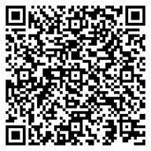
Study load requirements
It is your responsibility to ensure you meet your specific study load requirements (e.g. minimum load).
You may have specific requirements if you are a:
Sponsored student
Scholarship recipients
Live in student accommodation
International student visa holder
  Information for International Student Visa Holders
  https://www.anu.edu.au/students/program-administration/program-management/information-for-international-student-visa-holders-studying-in-australia

Slide 22
How do I calculate my study load?
Each course has a unit value, which is listed on the course page on Programs and Courses.
Most standard courses are 6 units.
Study load is calculated based on your total unit load in each study period (half year):
Study period 1 = Summer Session, Semester 1, Autumn Session
Study period 2 = Winter Session, Semester 2, Spring Session
Minimum study load
Domestic students:
Can generally choose to study part-time (less than 18 units) or full-time (more than 18 units)
Students on an international student visa:
Must complete your program within the expected duration on your Confirmation of Enrolment (CoE)
Expected to study full-time (24 units per study period)
Maximum study load
The standard maximum load per study period is 24 units
ANUHub will prevent you from overloading (exceeding 24 units)
To overload, you need to meet minimum eligibility requirements and receive approval.
Generally, not possible to overload in your first teaching session.

Slide 23
Teaching periods
Standard teaching periods
Semester 1 and Semester 2
Most common teaching sessions for most courses.
Each course follows a standard schedule for teaching weeks, exam periods and administrative deadlines.
Non-standard teaching periods
Summer, Autumn, Winter and Spring Session
Courses offered in non-standard sessions don’t follow standard teaching period dates.
Each course has its own schedule, including teaching weeks, assessment timelines, and administrative deadlines.
Why you might enrol in a non-standard teaching period:
catch up on a course
spread or reduce your Semester 1 or 2 workload
accelerate your program
take an intensive or time-specific course

Slide 24



Enrolling on ANUHub
03
How do I enrol in the courses I've chosen?
Do I need a permission code?

Slide 25
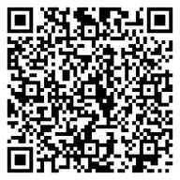
What is ANUHub?
    Once you have chosen your courses, you will enrol on ANUHub, the ANU system that will allow you to:
    Enrol in, swap or drop courses
    View invoices, receipts and manage fees
    Download documents confirming your course, program and grades
    Submit eForm applications (e.g. reduce study load, degree transfer)
    Update your personal details (phone, address, emergency contact)
  Enrol for the first time as a coursework student:
  https://www.anu.edu.au/students/program-administration/enrolment/enrol-for-the-first-time-as-a-coursework-student

Slide 26
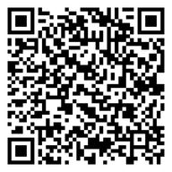
Student Task Wizard
    Login to ANUHub using your ANU ID (e.g. u1234567) and password.
    The first time you login, you’ll be prompted to complete the Task Wizard, which will prompt you to:
    Confirm your personal details including your Unique Student Identifier
    Complete required declarations and forms
      If you are on a student visa, you must update your Australian residential address within 7 days of arrival (and within 7 days of any later change).
If you haven’t received your ANU ID number or first password, please visit:
https://www.anu.edu.au/students/program-administration/enrolment/havent-received-your-first-password ​

Slide 27

Unique Student Identifier (USI)
Your Unique Student Identifier (USI) is a reference number that provides you with access to an online record of your training achievements in Australia.
You can apply for a USI via https://www.usi.gov.au/.
Under the Higher Education Support Act 2003, all ANU students must provide a USI to:
be eligible for a Commonwealth Supported Place (CSP) or Commonwealth financial assistance (HECS-HELP, FEE-HELP, OS-HELP and SA-HELP); and/or
to graduate and receive their award.
You may be prompted to provide your USI in the ANUHub Task Wizard. If not, you should
provide it on ANUHub via the pathway:
NavBar (Compass Icon) > Menu > ANUHub > Personal Details > Unique Student Identifier
To learn more visit www.usi.gov.au. For further help, contact the Student Hubs team.

Slide 28
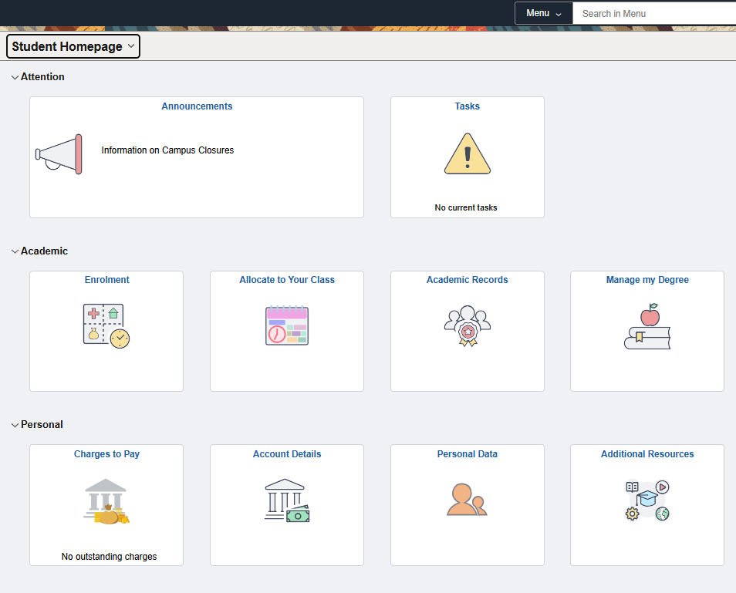
    Click the Enrolment tile on the ANUHub homepage

Slide 29
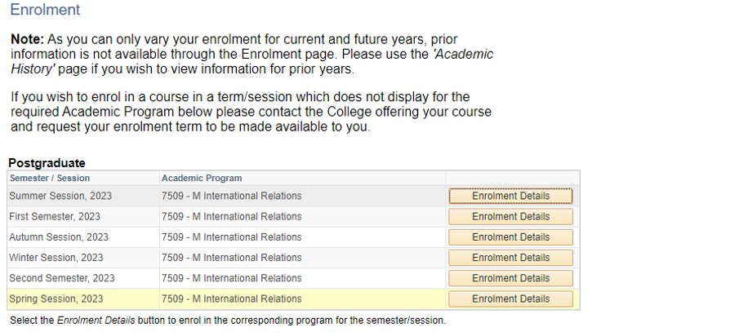
    Click the Enrolment Details button for the teaching session you wish to enrol in (e.g. Semester 1 2025)
If the teaching session doesn't appear or the enrolment details button is greyed out, contact the Student Hubs team:
https://www.anu.edu.au/students/contacts/anu-student-hubs

Slide 30
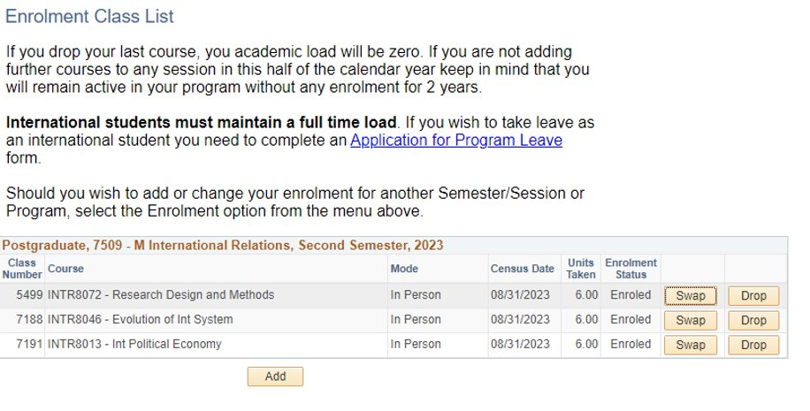
    Click the Add button to add (enrol in) new courses
    After you have enrolled, you can click the Swap or Drop buttons to make changes to courses you've already enrolled in (up to the relevant deadline).

Slide 31
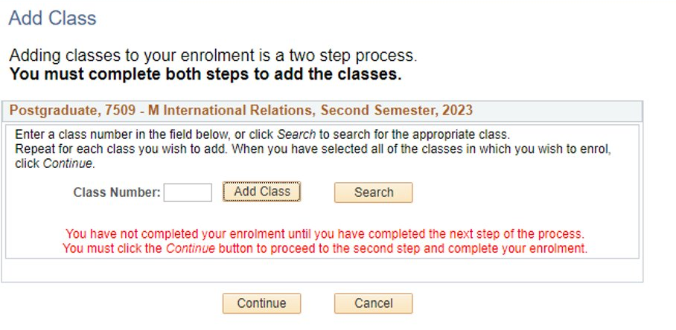
    Type the class number and click the Add Class button
Tip: Students generally find it easiest to enrol on ANUHub by entering the class number.
You can also use the search function in ANUHub to find the course. If so, you’ll need to select the correct discipline and find the specific course you’re looking to enrol in.

Slide 32
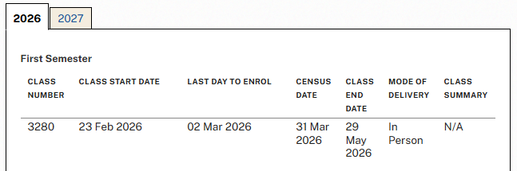
How do I find the class number?
The class number was the four digit number we found on the “Class” tab of the course page on Programs and Courses. For example, for ECON1101 in Semester 1 2026 the class number is 3280:
Class numbers are specific to the teaching session, so make sure you record the class number for the specific teaching session you’re trying to enrol in.

Slide 33
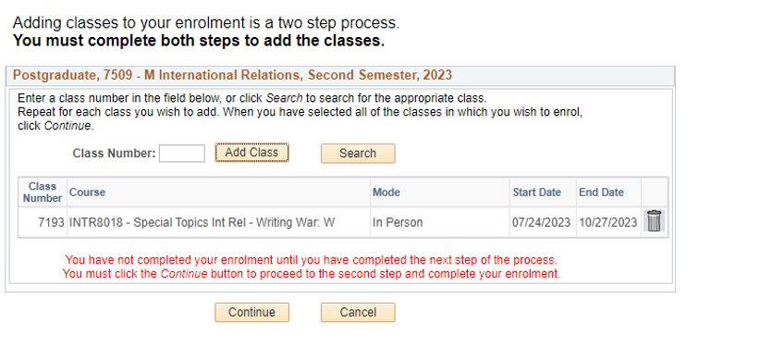
    The class will be added to the table below. Repeat the step to add additional classes to the table.
    Once all classes have been added to the table, click the Continue button to save your enrolment.

Slide 34
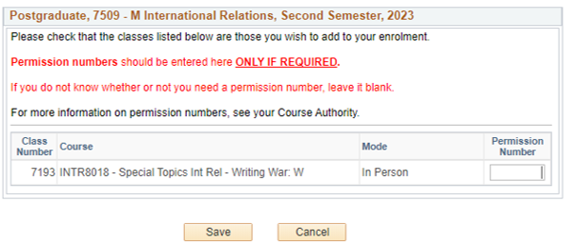
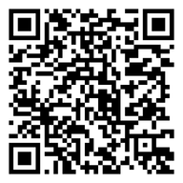
    If required, enter a permission code (also called a permission number).
    These are required when there are criteria you must meet before enrolling (requisites) or limited places in a course. Check the Requisite and incompatibility section of the course page on Programs and Courses.
  The online Application for Permission Code form and more information about Language Placement Tests can be found on the Permission Codes webpage:
  https://www.anu.edu.au/students/program-administration/enrolment/permission-codes

Slide 35
    Click the Save button to save your enrolment.
    If you’re not sure whether you need a permission number, leave it blank.

Slide 36
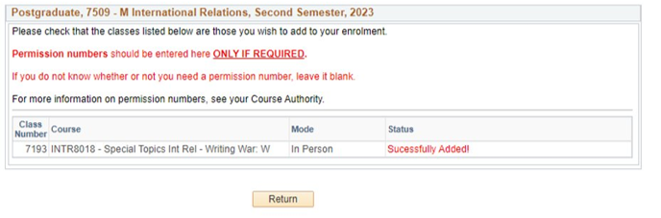
    You’ll either get:
    A “Successfully Added” message confirming you’ve enrolled in the course(s).
    An error message explaining why the course(s) could not be added.
If you receive an error message, follow the instructions to resolve the issue or contact ANU Student Hubs for assistance:
https://www.anu.edu.au/students/contacts/anu-student-hubs

Slide 37
Key Administrative dates
04
Dates you should keep in mind.

Slide 38
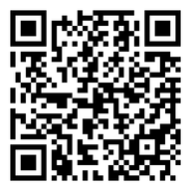
Semester 2 2026 administrative dates
Monday 27 July | Teaching begins
Monday 3 August | Last day to add or swap courses on ANUHub
Friday 14 August | Deadline to pay tuition fees and SSAF upfront
Monday 31 August Friday 9 October | Census Date: Last day to drop a course without financial or academic penalty Last day to submit eCAFs for CSP or HELP Last day to drop a course without failure (WD grade assigned)
University Calendar
www.anu.edu.au/directories/university-calendar

Slide 39
Census date
What is census date?
An administrative deadline that impacts a range of student enrolment and fee activities and is a strict deadline.
The census date for all Semester 2 2026 courses is Tuesday, 31 August 2026
    What does that mean?
    The census date is your last day to:
    Drop a course without financial or academic penalty
    Apply for program leave or reduced study load (international students)
    Update your residency status for the current semester
    Submit eCAFs for Commonwealth Supported Place or HELP loan
    If you drop a course after the census date, you will:
    Receive a grade on your academic transcript; and
    Remain liable for the tuition fee and associated costs for the course

Slide 40

AFTER enrolment
05
Do I need a textbook?
How will I access course materials?
ORIENTATION WEEK 20-24 JULY 2026

Slide 41

Allocate your classes on MyTimetable
Step-by-step guides are available to help you with timetabling, including:
Getting started
Creating a timetable plan
Class allocations, clashes, swaps and waitlists
Syncing your timetable with LiveCal
Come to one of our Build your timetable presentation and Q&A sessions this week for help.
    Timetabling guides and resources:
https://www.anu.edu.au/students/program-administration/timetabling/student-access-and-support-for-mytimetable
ORIENTATION WEEK 20-24 JULY 2026

Slide 42
Come to another information session
Date | Event | Format | Registration Link
Daily during O-Week (20-24 July) | Get enrolled | In person presentation and Q&A | Register here
 | Build your timetable | In person presentation and Q&A | Register here
Monday Week 2 3 August 2026 | Understanding Your Domestic Student Fees | Online presentation and Q&A (Zoom) | Register here
 | Understanding Your International Student Fees | Online presentation and Q&A (Zoom) | Register here
ORIENTATION WEEK 20-24 JULY 2026

Slide 43
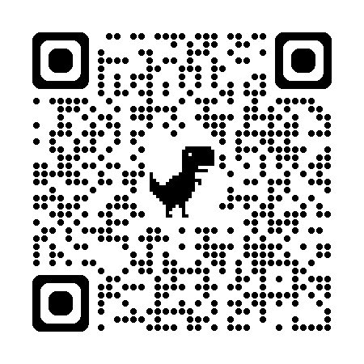
Access your course materials
You’ll access your learning materials through Canvas.
This includes:
Class summaries (also available via Programs & Courses)
Lecture recordings
Readings and resources
Assessments and grades
Announcements
Courses usually appear 1 - 2 weeks before teaching starts.
If not, contact ANU Student Hubs for help.
ANU Student Hubs
https://www.anu.edu.au/students/contacts/anu-student-hubs
ORIENTATION WEEK 20-24 JULY 2026
Notes:
Each academic college at ANU has their own process for assessing credit and exemption requests for recognition of prior learning. You can scan the QR code on this page or go to the linked page and you will find more information about how to get the correct information for your college.

Slide 44

Know where to get help at ANU
ANU Student Hubs can help answer questions, resolve issues and connect you to the right support.
Managing your degree and enrolment
Timetabling support
Course and program advice
University systems and processes
Fees and payments
Records and documents
Student card collection
Allianz overseas student health cover (OSHC)
IT support
University Accommodation
ORIENTATION WEEK 20-24 JULY 2026
Notes:
ANU Health and Wellbeing Services
The ANU Health and Wellbeing teams provide free support to all currently enrolled students. Their services are non crisis, trauma-informed, person-centred, and designed to support students' wellbeing, safety, health, and success at university.
Student Safety and Wellbeing Team (SSWT)
The Student Safety and Wellbeing Team supports students experiencing academic, mental health, or personal challenges. Through case management, the team helps students navigate difficulties that may affect their university experience and connects them with appropriate ANU and community supports.
The team also provides specialised support for students who have experienced harmful behaviours such as bullying, discrimination, harassment, sexual harassment, or sexual assault. Responses to disclosures are trauma-informed and student-centred.
Counselling
ANU Counselling provides wellbeing support for students experiencing a range of concerns including stress, personal difficulties, or challenges adjusting to university life. Through individual appointments, groups, workshops, and online resources, counselling helps students build coping skills, resilience, and strategies to support their wellbeing and academic success.
Intake Team
Students can access ANU Counselling and Student Safety and Wellbeing services by completing the online Intake Form. An Intake clinician will then contact the student to discuss their circumstances, assess their needs, and help connect them with the most appropriate support services.
Accessibility
Accessibility Services supports students with supports students with disability, long or short-term health conditions, , or caring responsibilities. The team works with students to develop access plans and reasonable adjustments that support participation in university. Information about registration can be found on the website and students are encouraged to reach out early as appointments book up in peak periods.
ANU Medical Centre
The ANU Medical Centre provides primary health care for students and staff, including general medical care, sexual health services, immunisations, referrals, and telehealth appointments. Most services are provided at no cost to students through Medicare or Overseas Student Health Cover (OSHC).

Slide 45

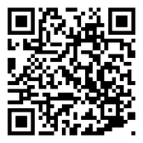
Visit Student Hub Kambri
Level 1, Di Riddell Student Centre, Building 154
University Avenue, Kambri
Monday, Tuesday, Thursday and Friday: 10am–4pm
Wednesday: 10am–5pm
Email
student@anu.edu.au
Phone
+61 2 6125 3339
Monday to Friday: 10am-4pm
Course and Program Advice
Email student@anu.edu.au from your ANU student email account.
Our course and program advisers are prioritising email support so they can properly review each student’s program and individual circumstances. This also allows specialist staff to process the high volume of credit, permission code, enrolment change and other requests as quickly as possible.
ANU Student Hubs
https://www.anu.edu.au/students/contacts/anu-student-hubs
ORIENTATION WEEK 20-24 JULY 2026
Notes:
ANU Health and Wellbeing Services
The ANU Health and Wellbeing teams provide free support to all currently enrolled students. Their services are non crisis, trauma-informed, person-centred, and designed to support students' wellbeing, safety, health, and success at university.
Student Safety and Wellbeing Team (SSWT)
The Student Safety and Wellbeing Team supports students experiencing academic, mental health, or personal challenges. Through case management, the team helps students navigate difficulties that may affect their university experience and connects them with appropriate ANU and community supports.
The team also provides specialised support for students who have experienced harmful behaviours such as bullying, discrimination, harassment, sexual harassment, or sexual assault. Responses to disclosures are trauma-informed and student-centred.
Counselling
ANU Counselling provides wellbeing support for students experiencing a range of concerns including stress, personal difficulties, or challenges adjusting to university life. Through individual appointments, groups, workshops, and online resources, counselling helps students build coping skills, resilience, and strategies to support their wellbeing and academic success.
Intake Team
Students can access ANU Counselling and Student Safety and Wellbeing services by completing the online Intake Form. An Intake clinician will then contact the student to discuss their circumstances, assess their needs, and help connect them with the most appropriate support services.
Accessibility
Accessibility Services supports students with supports students with disability, long or short-term health conditions, , or caring responsibilities. The team works with students to develop access plans and reasonable adjustments that support participation in university. Information about registration can be found on the website and students are encouraged to reach out early as appointments book up in peak periods.
ANU Medical Centre
The ANU Medical Centre provides primary health care for students and staff, including general medical care, sexual health services, immunisations, referrals, and telehealth appointments. Most services are provided at no cost to students through Medicare or Overseas Student Health Cover (OSHC).

Slide 46
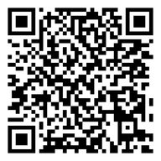
Know where to get help at ANU
  The ANU Service Desk is the central point of contact for IT support, including:
Issuing or resetting your password
Help with multi-factor authentication (MFA)
Accessing ANU Secure Wi-Fi on campus
If you haven’t received your ANU ID number or your first password, visit:
https://www.anu.edu.au/students/program-administration/enrolment/havent-received-your-first-password ​
Accessing IT help and support webpage:
https://services.anu.edu.au/information-technology/it-help-support
ORIENTATION WEEK 20-24 JULY 2026

Slide 47




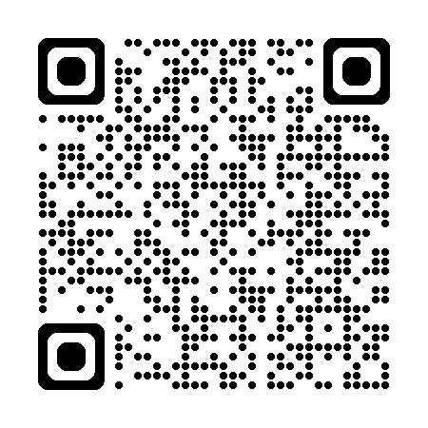
Know where to get help at ANU
Student Safety and Wellbeing Team | ANU Counselling | Accessibility | ANU Medical Centre
Support for academic, mental health, and personal challenges. Trauma-informed response to disclosures of harmful behaviours. Help navigating internal and external resources, university processes, and wellbeing support. | Short-term psychological support through counselling Offers groups, workshops, and online resources Non-diagnostic service; no diagnosis or Mental Health Treatment Plan required. | Supports students with disabilities and/or long or short-term health conditions. Also provides support to elite athletes and carers. Creates Education Access Plans (EAPs) with recommended academic adjustments. | Appointments with doctors, nurse practitioners, and nurses for students and staff. Services include sexual health, immunisations, minor procedures, referrals, and telehealth. Bulk-billed for students with Medicare or OSHC; fees apply for missed appointments. Book online - https://www.hotdoc.com.au/medical-centres/canberra-ACT-2600/anu-medical-centre/doctors
Health, safety and wellbeing services
ORIENTATION WEEK 20-24 JULY 2026
Notes:
ANU Health and Wellbeing Services
The ANU Health and Wellbeing teams provide free support to all currently enrolled students. Their services are non crisis, trauma-informed, person-centred, and designed to support students' wellbeing, safety, health, and success at university.
Student Safety and Wellbeing Team (SSWT)
The Student Safety and Wellbeing Team supports students experiencing academic, mental health, or personal challenges. Through case management, the team helps students navigate difficulties that may affect their university experience and connects them with appropriate ANU and community supports.
The team also provides specialised support for students who have experienced harmful behaviours such as bullying, discrimination, harassment, sexual harassment, or sexual assault. Responses to disclosures are trauma-informed and student-centred.
Counselling
ANU Counselling provides wellbeing support for students experiencing a range of concerns including stress, personal difficulties, or challenges adjusting to university life. Through individual appointments, groups, workshops, and online resources, counselling helps students build coping skills, resilience, and strategies to support their wellbeing and academic success.
Intake Team
Students can access ANU Counselling and Student Safety and Wellbeing services by completing the online Intake Form. An Intake clinician will then contact the student to discuss their circumstances, assess their needs, and help connect them with the most appropriate support services.
Accessibility
Accessibility Services supports students with supports students with disability, long or short-term health conditions, , or caring responsibilities. The team works with students to develop access plans and reasonable adjustments that support participation in university. Information about registration can be found on the website and students are encouraged to reach out early as appointments book up in peak periods.
ANU Medical Centre
The ANU Medical Centre provides primary health care for students and staff, including general medical care, sexual health services, immunisations, referrals, and telehealth appointments. Most services are provided at no cost to students through Medicare or Overseas Student Health Cover (OSHC).

Slide 48



Register for Set4ANU Mentoring
Register now! Spots are limited!
Join the Set4ANU mentoring program to be matched with a friendly senior student mentor!
Set4ANU is a fun, free, 8-week group mentoring program.
Your mentor will help ease you into the university by helping you:
    Make new friends and meet other new students,
    Help you build your university study skills,
    Guide you around ANU!
  Visit our website for more information.
  Email Isabelle at: studenttransition.seem@anu.edu.au
  Mentee registrations close Sunday 2 August 2026
ORIENTATION WEEK 20-24 JULY 2026

Slide 49
Thank you
Contact Us
  ANU Student Hubs
  +61 2 6125 3339
  student@anu.edu.au
  https://www.anu.edu.au/students/contacts/anu-student-hubs
Visit the ANU Student Hubs webpage to download a copy of the slides

