Slide 1
BUILD YOUR TIMETABLE:
Timetabling presentation and Q&A
  Semester 2 2026

Slide 2

Acknowledgement of Country
We acknowledge the Ngunnawal and Ngambri peoples as the Traditional Custodians of the land on which the ANU Acton campus is located.
We honour their continuing connection to Country and the knowledge, care and community that shape learning and belonging at ANU, and pay our respects to Elders past and present.

Slide 3


Agenda
01 | Timetabling systems
02 | Class types
03 | Navigating MyTimetable
04 | Troubleshooting timetable issues
05 | View & export your timetable
06 | After timetabling
What topics will the session cover?

Slide 4
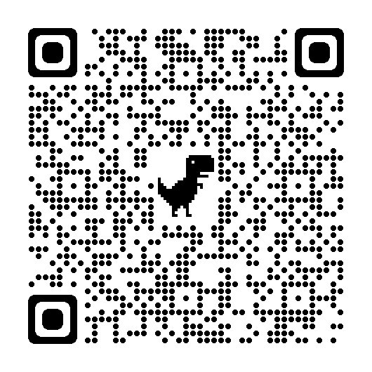
Need some extra help choosing your classes?
Program area | Program planning guides
ANU College of Arts and Social Sciences (CASS) | https://cass.anu.edu.au/current-students/degrees-and-program-plans
ANU College of Asia and the Pacific (CAP) | Undergraduate: https://asiapacific.anu.edu.au/cap-student-centre#section-13346 Postgraduate: https://programsandcourses.anu.edu.au/catalogue
ANU College of Business and Economics (CBE) | https://cbe.anu.edu.au/current-students/program-planning/fast-track
ANU College of Law, Governance and Policy (CLGP) | https://law.anu.edu.au/welcome-anu-law-school
ANU College of Science and Medicine (CoSM) | Undergraduate: https://students.science.anu.edu.au/program-admin/structuring-your-degree Postgraduate: https://programsandcourses.anu.edu.au/catalogue
ANU College of Systems and Society (CSS) | https://programsandcourses.anu.edu.au/catalogue and https://systems.anu.edu.au/students/continuing/
Enrol in courses (ANUHub)
Courses sync overnight
Allocate to classes (MyTimetable)
  Enrol for the first time as a coursework student:
  https://quicklink.anu.edu.au/72zl

Slide 5

Timetabling guides
Step-by-step guides are available to help you with timetabling, including:
Getting started
Creating a timetable plan
Class allocations, clashes, swaps and waitlists
Syncing your timetable with LiveCal
    Timetabling guides and resources:
https://www.anu.edu.au/students/program-administration/timetabling/student-access-and-support-for-mytimetable

Slide 6
TIMETABLING SYSTEMS
01

Slide 7
MyTimetable
MyTimetable is the official timetabling and class allocation system for ANU students.
You will use MyTimetable to:
Allocate yourself to classes (teaching activities such as tutorials, workshops, and labs)
View and download your personal timetable
Share your timetable with friends and classmates.
Semester 2 2026 class allocations opened on Monday 13 July 2026.
Link to this year’s MyTimetable:
https://quicklink.anu.edu.au/iqet
Tip: All activities at ANU start at 5 minutes past the hour and finish at 5 minutes to the hour.

Slide 8
Web Publisher
The Web Publisher allows you to view class details for planning purposes.
You can use the Web Publisher to plan before class allocations open on MyTimetable, even if you have not yet enrolled in courses on ANUHub.
The Web Publisher shows all scheduled activities for a course. Some classes might not be available to you once MyTimetable opens (for example, activities restricted to specific student cohorts).
Link to this year’s Web Publisher:
https://quicklink.anu.edu.au/iqet

Slide 9
What’s the difference?
Web Publisher
View class schedules for planning
Available before allocations open
Helps you choose preferred times and check
for clashes
MyTimetable
Allocate yourself to classes
Generate your personalised timetable
Tip: Class details can change after allocations open. This may occur for a variety of reasons including increased enrolment numbers or teaching staff updates. The time, day, or location of a class may change, and additional class options may be added.

Slide 10




Class types
02
Are lectures recorded?
What exactly is a seminar?

Slide 11
Class types at ANU
Type | Description | Clashable vs unclashable (how to tell)
Lectures | Large-group sessions where core concepts and theories are introduced. | 🎥 Recorded → usually clashable
Tutorials | Smaller classes for discussion, problem solving, and deeper engagement with content. | 👥 Interactive → usually unclashable
Lectorials | Combination of a lecture and tutorial | 🎥 Recorded + 👥 Interactive → usually unclashable
Workshops or Seminars | Interactive sessions that mix discussion, group activities or applied tasks. | 👥 Interactive → usually unclashable
Laboratories or Practicals | Hands-on classes focussed on experiments or practical skills. | 👥 Interactive → usually unclashable
Clinics, Fieldwork or Studio | Specialised learning experiences. | 👥 Interactive → usually unclashable
Assessment sessions | Scheduled assessment activities. | 👥 Interactive → usually unclashable
Drop-in or Support classes | Optional support or extra practice. | Optional - usually clashable
Your timetable will have a variety of teaching activities (classes). Here are some common ones.
Participating in classes:
https://quicklink.anu.edu.au/qrop
Teaching delivery types:
https://quicklink.anu.edu.au/v1a9
Abbreviations for class types:
https://quicklink.anu.edu.au/9jkt

Slide 12
Clashable or unclashable?
Clashable
Unclashable
Some activities in MyTimetable are marked as clashable.
MyTimetable will allow the activity to overlap with another class in your timetable.
This is usually because you do not need to attend at the scheduled time, such as a recorded lecture.
All lectures are recorded and posted to the Canvas page for the course.
Some activities in MyTimetable are marked as unclashable.
MyTimetable will not allow the activity to overlap with another unclashable class in your timetable.
These are usually activities where you are expected to attend or participate at the scheduled time, such as tutorials, labs, practicals, seminars, workshops or live online classes.
We will talk about how to manage clashes later in this session.
ORIENTATION WEEK 20-24 JULY 2026

Slide 13
Why do some classes look like repeats?
Letters (A, B, C) = different content
Numbers (1, 2, 3) = same content, repeated
If a class has a different letter, it’s a different activity with new content.
LecA/01 and LecB/01 are different lectures. You would need to allocate to and attend both.
If a class has the same letter but different numbers, it is the same class repeated at different times.
TutA/01 and TutA/02 are different offerings of the same class. You would need to allocate to and attend one.
Scenario
Aisha’s timetable shows the following classes for POLS1002
SemA/01 and SemB/01
Aisha allocates to both activities, because different letters mean different content.
Scenario
Peter’s timetable shows the following classes for ENGN2228
WorA/01, WorA/02, WorA/03 and WorA/04:
Peter allocates to one activity, because the same letter and different numbers mean this is the same class repeated multiple times.
ORIENTATION WEEK 20-24 JULY 2026

Slide 14
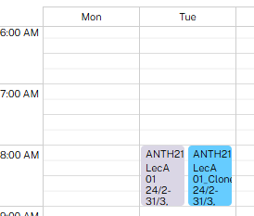
What does this mean?
Parent/Child courses
Clone course
These are usually in place where the same course is offered to different student cohorts (for example, undergraduate and postgraduate) with versions tailored to each program or discipline.
They commonly share lectures but have separate tutorials, labs or workshops.
You only allocate to the classes shown for your course.
These are additional sessions shadowing the main lecture for a course.
They are created because the number of students enrolled exceeds the capacity of the room.
The clone lecture is available so that if the main lecture is full, you can still add the lecture to your timetable.
Scenario
Mike’s timetable shows the following classes for ANTH2129
LecA 01 &LecA 01 Clone
Mike allocates to one activity only (LecA 01).
The clone lecture only exists so that students can allocate to it if the main lecture is full.
ORIENTATION WEEK 20-24 JULY 2026

Slide 15


Navigating Mytimetable
03
How do I allocate to my classes?
ORIENTATION WEEK 20-24 JULY 2026

Slide 16
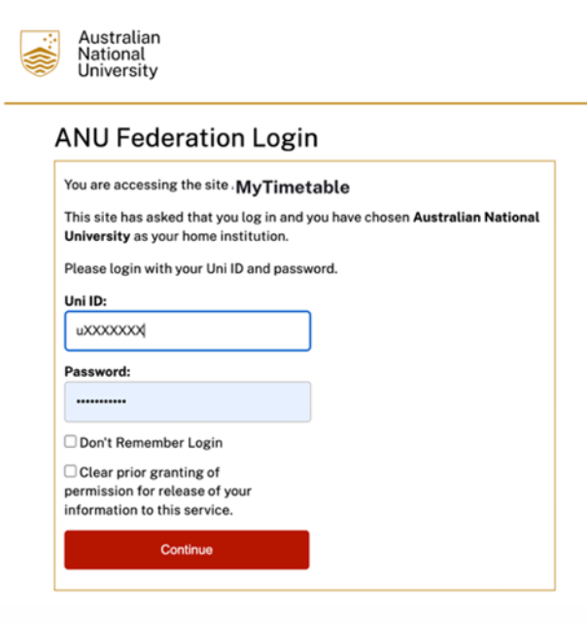
Accessing MyTimetable
Access MyTimetable on the webpage linked below.
Login using Single Sign-On (SSO).
Link to this year’s MyTimetable:
https://quicklink.anu.edu.au/iqet
ORIENTATION WEEK 20-24 JULY 2026

Slide 17
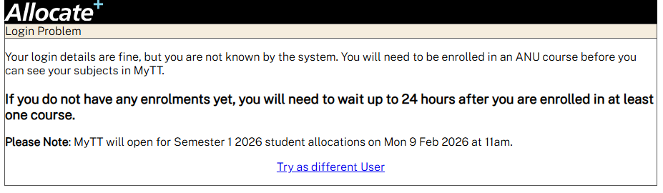
Why can’t I login?
If you see this error, it usually means your course enrolment has not yet synced from ANUHub to MyTimetable.
To access class allocations on MyTimetable, you must be enrolled in your courses in ANUHub.
MyTimetable syncs with ANUHub daily at 7am.
The first time you enrol on ANUHub, you will need to wait until after 7am the next day to allocate classes on MyTimetable.
ORIENTATION WEEK 20-24 JULY 2026

Slide 18
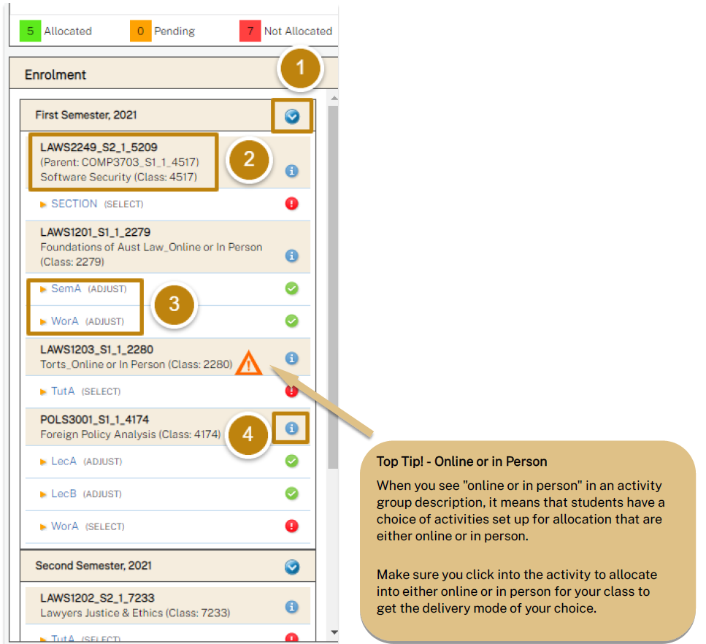
Using MyTimetable
Enrolment taskbar
Current course enrolments: arranged by teaching session.
Activities: lists each class type for your current course enrolments, with a corresponding icon to show the allocation status for that class type.
Subject information: click the information icon to go to the course page on Programs and Courses.
ORIENTATION WEEK 20-24 JULY 2026

Slide 19
Allocation statuses
These are a quick way to check your current allocation status for each of your classes:
Select: class not allocated. You need to choose a class time.
Adjust: class allocated. You can still swap to another class time.
Read only: class allocated. Available to view only.
Off: class is not currently available to view or allocate.
ORIENTATION WEEK 20-24 JULY 2026

Slide 20
Allocate to a class
Click on a class type (e.g. SemA, WorA) to view all offerings of that class.
You can only allocate to classes with a Select or Adjust status.
ORIENTATION WEEK 20-24 JULY 2026

Slide 21
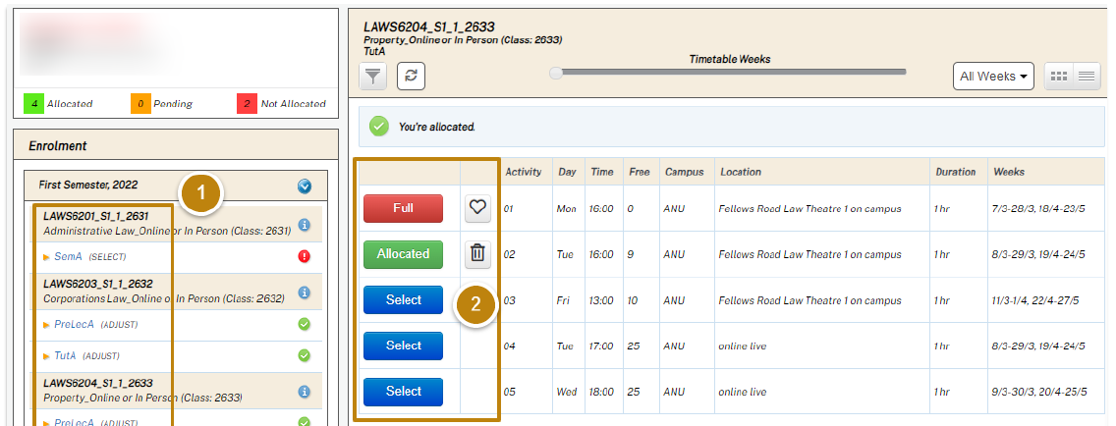
The window on the right will show the offerings (potential times) for that class.
Some classes may be automatically allocated, e.g. if there is only one offering of that class.
ORIENTATION WEEK 20-24 JULY 2026

Slide 22
Click Select next to the class time you want to allocate to.
The button will change to Allocated if you are successful. Repeat this process for all class types.
ORIENTATION WEEK 20-24 JULY 2026

Slide 23
Error messages
You will receive an error message if you cannot be allocated. If this occurs, it’s likely the class reached capacity after you loaded the page in MyTimetable. You will need to select a different class time.
ORIENTATION WEEK 20-24 JULY 2026

Slide 24
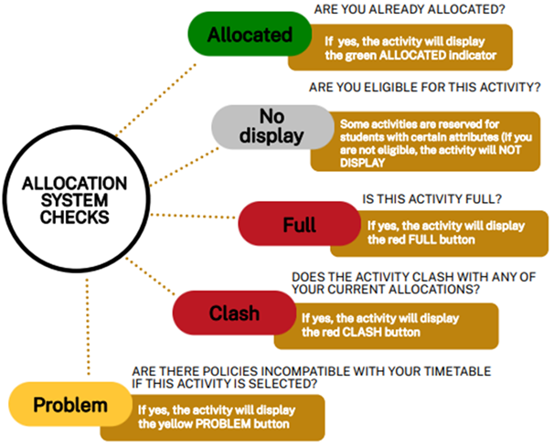
Allocation buttons
These indicate your current status for each class time.
Common statuses:
Allocated: you’re currently assigned to this class time.
Select: click to allocate or swap to this class time.
Full: there are no spaces left for this class time.
Clash: this class time clashes with your other allocated classes.
ORIENTATION WEEK 20-24 JULY 2026

Slide 25
View clash details
Click the Clash button to see what other allocated activity this class time clashes with.
You may be able to rearrange your timetable to avoid this clash.
ORIENTATION WEEK 20-24 JULY 2026

Slide 26
Troubleshooting timetable issues
04
Help! My classes clash!
ORIENTATION WEEK 20-24 JULY 2026

Slide 27
What if a class is full?
If the class time you want is full, you won’t be able to allocate to it.
Class sizes are limited due to room capacity and to support a good learning experience.
What you can do
Click the heart icon next to a class time to submit a waitlist request:
  You can submit multiple requests for the same class type.
  Requests are processed in the order they are received.
  If your request is approved, you will be automatically allocated to the new timeslot.
  Make sure you cancel any requests you no longer want.
If more students enrol in a course than expected, there may not initially be enough class spaces available.
Your course convener will manage this and communicate with students
if more class times become available for self-allocation.
Please try to wait for further advice. It can take time to arrange suitable rooms and teaching staff.
ORIENTATION WEEK 20-24 JULY 2026

Slide 28
What if a class is missing or read-only?
Some class activities may not appear immediately in MyTimetable.
This may be because:
Your ANUHub enrolment has not synced to MyTimetable yet. This can take up to 24 hours after enrolment.
The class activity is still being finalised by the teaching area.
Room availability or teaching staff arrangements are still being confirmed.
The course does not require you to allocate to that activity.
What you can do
Check that you are enrolled in the course in ANUHub.
Check your ANU email for course updates.
Check the course site on Canvas for announcements.
Wait for advice from your course convenor if class arrangements are still being finalised.
Your course convenor is the best contact for updates about course-specific timetable arrangements.
ORIENTATION WEEK 20-24 JULY 2026

Slide 29
What if my classes clash?
Timetable clashes are common. Course timetables are built for thousands of students, so some overlaps are sometimes unavoidable. If your timetable shows a clash:
What does it clash with?
Click the red Clash button to view the activity details.
Is one activity clashable?
You can allocate into a clashing class if it’s with a clashable activity.
Can you choose a different class time?
Click Select on a different class time if available for either of the clashing classes.
Can you rearrange other class allocations?
You might be able to swap into a different class time for the other clashing class or move around some other allocations to make things fit.
Tip: If you are using recordings to manage a clash, set a weekly catch-up time in your calendar or diary so you don’t fall behind.
ORIENTATION WEEK 20-24 JULY 2026

Slide 30
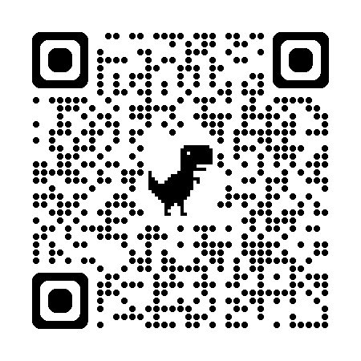
What if I can’t resolve a clash?
Sometimes clashes can’t be resolved, such as when two compulsory, unclashable activities overlap and there are no alternatives.
You may need to enrol in a different course.
If the courses with clashing classes are compulsory for your program, or you aren’t sure what else to enrol in, contact ANU Student Hubs by emailing student@anu.edu.au for course and program advice.
ANU Student Hubs
https://www.anu.edu.au/students/contacts/anu-student-hubs
ORIENTATION WEEK 20-24 JULY 2026

Slide 31
View & export your timetable
05
ORIENTATION WEEK 20-24 JULY 2026

Slide 32
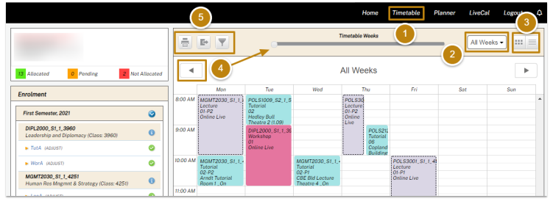
View your personal timetable
Once you have allocated yourself to your class activities, you will be able to generate your timetable:
Click Timetable to see your full timetable
Use the dropdown to show all weeks
Switch between grid or list view
Use the slider to view a specific week
Use the icons to Print, Download, or Filter your timetable by semester
ORIENTATION WEEK 20-24 JULY 2026

Slide 33
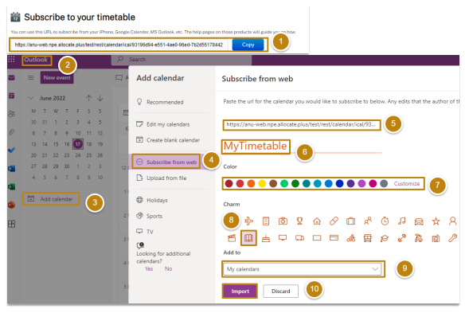
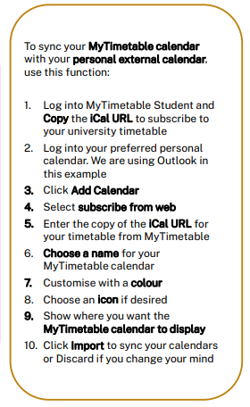
Export your timetable to your external calendar
ORIENTATION WEEK 20-24 JULY 2026

Slide 34


AFTER TIMETABLING
06
Do I need a textbook?
How will I access course materials?
ORIENTATION WEEK 20-24 JULY 2026

Slide 35
Access your course materials
You’ll access your learning materials through Canvas.
This includes:
Class summaries (also available via Programs & Courses)
Lecture recordings
Readings and resources
Assessments and grades
Announcements
Courses usually appear 1 - 2 weeks before teaching starts.
If not, contact ANU Student Hubs for help.
ANU Student Hubs
https://www.anu.edu.au/students/contacts/anu-student-hubs
ORIENTATION WEEK 20-24 JULY 2026
Notes:
Each academic college at ANU has their own process for assessing credit and exemption requests for recognition of prior learning. You can scan the QR code on this page or go to the linked page and you will find more information about how to get the correct information for your college.

Slide 36

Know where to get help at ANU
ANU Student Hubs can help answer questions, resolve issues and connect you to the right support.
Managing your degree and enrolment
Timetabling support
Course and program advice
University systems and processes
Fees and payments
Records and documents
Student card collection
Allianz overseas student health cover (OSHC)
IT support
University Accommodation
ORIENTATION WEEK 20-24 JULY 2026
Notes:
ANU Health and Wellbeing Services
The ANU Health and Wellbeing teams provide free support to all currently enrolled students. Their services are non crisis, trauma-informed, person-centred, and designed to support students' wellbeing, safety, health, and success at university.
Student Safety and Wellbeing Team (SSWT)
The Student Safety and Wellbeing Team supports students experiencing academic, mental health, or personal challenges. Through case management, the team helps students navigate difficulties that may affect their university experience and connects them with appropriate ANU and community supports.
The team also provides specialised support for students who have experienced harmful behaviours such as bullying, discrimination, harassment, sexual harassment, or sexual assault. Responses to disclosures are trauma-informed and student-centred.
Counselling
ANU Counselling provides wellbeing support for students experiencing a range of concerns including stress, personal difficulties, or challenges adjusting to university life. Through individual appointments, groups, workshops, and online resources, counselling helps students build coping skills, resilience, and strategies to support their wellbeing and academic success.
Intake Team
Students can access ANU Counselling and Student Safety and Wellbeing services by completing the online Intake Form. An Intake clinician will then contact the student to discuss their circumstances, assess their needs, and help connect them with the most appropriate support services.
Accessibility
Accessibility Services supports students with supports students with disability, long or short-term health conditions, , or caring responsibilities. The team works with students to develop access plans and reasonable adjustments that support participation in university. Information about registration can be found on the website and students are encouraged to reach out early as appointments book up in peak periods.
ANU Medical Centre
The ANU Medical Centre provides primary health care for students and staff, including general medical care, sexual health services, immunisations, referrals, and telehealth appointments. Most services are provided at no cost to students through Medicare or Overseas Student Health Cover (OSHC).

Slide 37

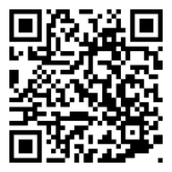
Visit Student Hub Kambri
Level 1, Di Riddell Student Centre, Building 154
University Avenue, Kambri
Monday, Tuesday, Thursday and Friday: 10am–4pm
Wednesday: 10am–5pm
Email
student@anu.edu.au
Phone
+61 2 6125 3339
Monday to Friday: 10am-4pm
Course and Program Advice
Email student@anu.edu.au from your ANU student email account.
Our course and program advisers are prioritising email support so they can properly review each student’s program and individual circumstances. This also allows specialist staff to process the high volume of credit, permission code, enrolment change and other requests as quickly as possible.
ANU Student Hubs
https://www.anu.edu.au/students/contacts/anu-student-hubs
ORIENTATION WEEK 20-24 JULY 2026
Notes:
ANU Health and Wellbeing Services
The ANU Health and Wellbeing teams provide free support to all currently enrolled students. Their services are non crisis, trauma-informed, person-centred, and designed to support students' wellbeing, safety, health, and success at university.
Student Safety and Wellbeing Team (SSWT)
The Student Safety and Wellbeing Team supports students experiencing academic, mental health, or personal challenges. Through case management, the team helps students navigate difficulties that may affect their university experience and connects them with appropriate ANU and community supports.
The team also provides specialised support for students who have experienced harmful behaviours such as bullying, discrimination, harassment, sexual harassment, or sexual assault. Responses to disclosures are trauma-informed and student-centred.
Counselling
ANU Counselling provides wellbeing support for students experiencing a range of concerns including stress, personal difficulties, or challenges adjusting to university life. Through individual appointments, groups, workshops, and online resources, counselling helps students build coping skills, resilience, and strategies to support their wellbeing and academic success.
Intake Team
Students can access ANU Counselling and Student Safety and Wellbeing services by completing the online Intake Form. An Intake clinician will then contact the student to discuss their circumstances, assess their needs, and help connect them with the most appropriate support services.
Accessibility
Accessibility Services supports students with supports students with disability, long or short-term health conditions, , or caring responsibilities. The team works with students to develop access plans and reasonable adjustments that support participation in university. Information about registration can be found on the website and students are encouraged to reach out early as appointments book up in peak periods.
ANU Medical Centre
The ANU Medical Centre provides primary health care for students and staff, including general medical care, sexual health services, immunisations, referrals, and telehealth appointments. Most services are provided at no cost to students through Medicare or Overseas Student Health Cover (OSHC).

Slide 38
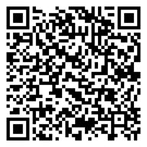
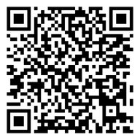
Know where to get help at ANU
  The ANU Service Desk is the central point of contact for IT support, including:
Issuing or resetting your password
Help with multi-factor authentication (MFA)
Accessing ANU Secure Wi-Fi on campus
If you haven’t received your ANU ID number or your first password, visit:
https://www.anu.edu.au/students/program-administration/enrolment/havent-received-your-first-password ​
Accessing IT help and support webpage:
https://services.anu.edu.au/information-technology/it-help-support
ORIENTATION WEEK 20-24 JULY 2026

Slide 39

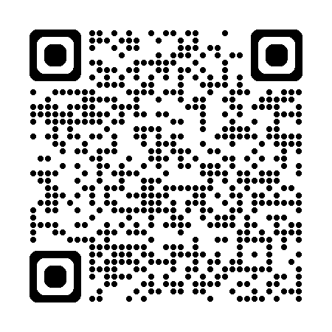

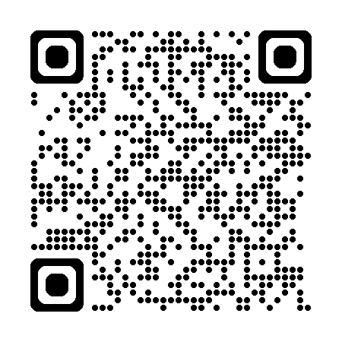
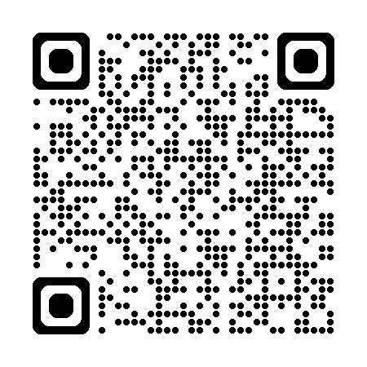
Know where to get help at ANU
Student Safety and Wellbeing Team | ANU Counselling | Accessibility | ANU Medical Centre
Support for academic, mental health, and personal challenges. Trauma-informed response to disclosures of harmful behaviours. Help navigating internal and external resources, university processes, and wellbeing support. | Short-term psychological support through counselling Offers groups, workshops, and online resources Non-diagnostic service; no diagnosis or Mental Health Treatment Plan required. | Supports students with disabilities and/or long or short-term health conditions. Also provides support to elite athletes and carers. Creates Education Access Plans (EAPs) with recommended academic adjustments. | Appointments with doctors, nurse practitioners, and nurses for students and staff. Services include sexual health, immunisations, minor procedures, referrals, and telehealth. Bulk-billed for students with Medicare or OSHC; fees apply for missed appointments. Book online - https://www.hotdoc.com.au/medical-centres/canberra-ACT-2600/anu-medical-centre/doctors
Health, safety and wellbeing services
ORIENTATION WEEK 20-24 JULY 2026
Notes:
ANU Health and Wellbeing Services
The ANU Health and Wellbeing teams provide free support to all currently enrolled students. Their services are non crisis, trauma-informed, person-centred, and designed to support students' wellbeing, safety, health, and success at university.
Student Safety and Wellbeing Team (SSWT)
The Student Safety and Wellbeing Team supports students experiencing academic, mental health, or personal challenges. Through case management, the team helps students navigate difficulties that may affect their university experience and connects them with appropriate ANU and community supports.
The team also provides specialised support for students who have experienced harmful behaviours such as bullying, discrimination, harassment, sexual harassment, or sexual assault. Responses to disclosures are trauma-informed and student-centred.
Counselling
ANU Counselling provides wellbeing support for students experiencing a range of concerns including stress, personal difficulties, or challenges adjusting to university life. Through individual appointments, groups, workshops, and online resources, counselling helps students build coping skills, resilience, and strategies to support their wellbeing and academic success.
Intake Team
Students can access ANU Counselling and Student Safety and Wellbeing services by completing the online Intake Form. An Intake clinician will then contact the student to discuss their circumstances, assess their needs, and help connect them with the most appropriate support services.
Accessibility
Accessibility Services supports students with supports students with disability, long or short-term health conditions, , or caring responsibilities. The team works with students to develop access plans and reasonable adjustments that support participation in university. Information about registration can be found on the website and students are encouraged to reach out early as appointments book up in peak periods.
ANU Medical Centre
The ANU Medical Centre provides primary health care for students and staff, including general medical care, sexual health services, immunisations, referrals, and telehealth appointments. Most services are provided at no cost to students through Medicare or Overseas Student Health Cover (OSHC).

Slide 40

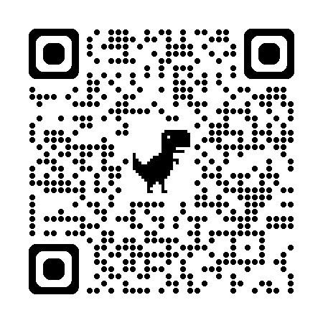

Register for Set4ANU Mentoring
Register now! Spots are limited!
Join the Set4ANU mentoring program to be matched with a friendly senior student mentor!
Set4ANU is a fun, free, 8-week group mentoring program.
Your mentor will help ease you into the university by helping you:
    Make new friends and meet other new students,
    Help you build your university study skills,
    Guide you around ANU!
  Visit our website for more information.
  Email Isabelle at: studenttransition.seem@anu.edu.au
  Mentee registrations close Sunday 2 August 2026
ORIENTATION WEEK 20-24 JULY 2026

Slide 41
Come to another information session
Date | Event | Format | Registration Link
Daily during O-Week (20-24 July) | Get enrolled | In person presentation and Q&A | Register here
 | Build your timetable | In person presentation and Q&A | Register here
Monday Week 2 3 August 2026 | Understanding Your Domestic Student Fees | Online presentation and Q&A (Zoom) | Register here
 | Understanding Your International Student Fees | Online presentation and Q&A (Zoom) | Register here
ORIENTATION WEEK 20-24 JULY 2026

Slide 42
Thank you
Contact Us
  ANU Student Hubs
  +61 2 6125 3339
  student@anu.edu.au
  https://www.anu.edu.au/students/contacts/anu-student-hubs
Visit the ANU Student Hubs webpage to download a copy of the slides

